Slide 1
EAT, COOK, REPEAT
Bagus Dzikri Hidayat
BZ7830

Slide 2
Goals
Completing the API task in PijarCamp scholarship
Designing and developing the backend for Eat, Cook, Repeat recipe application
Designing the social media platform for all cooks to share all their recipes to everyone

Slide 3
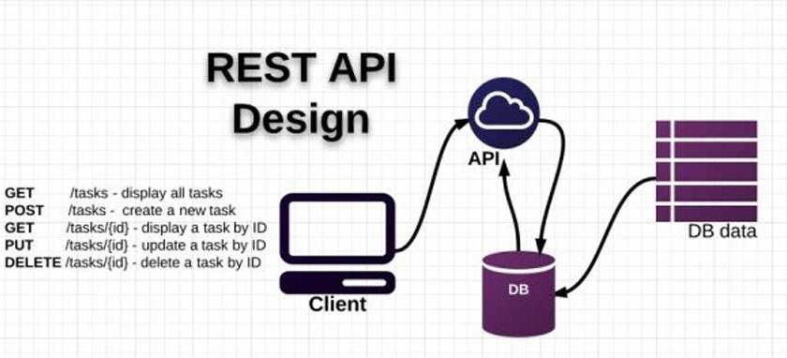




Tech Stack

Slide 4
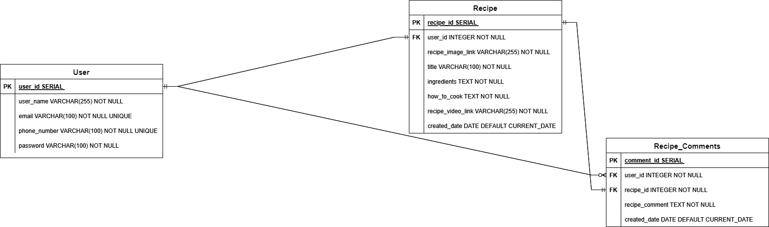
Entity Relational Diagram

Slide 5
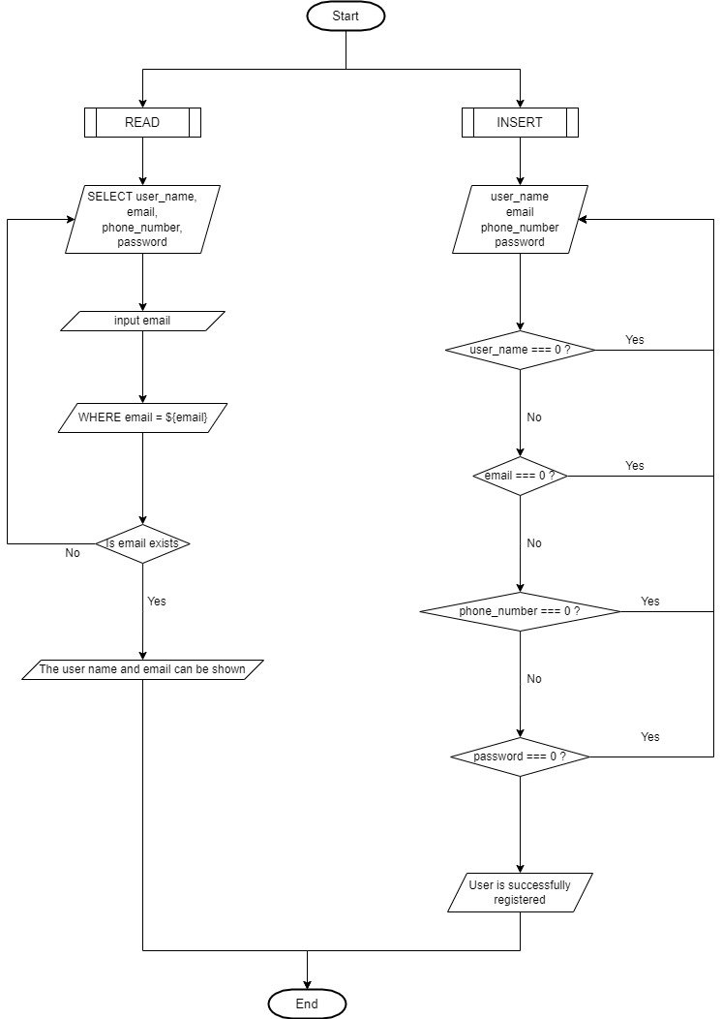
User CRUD Flowchart

Slide 6
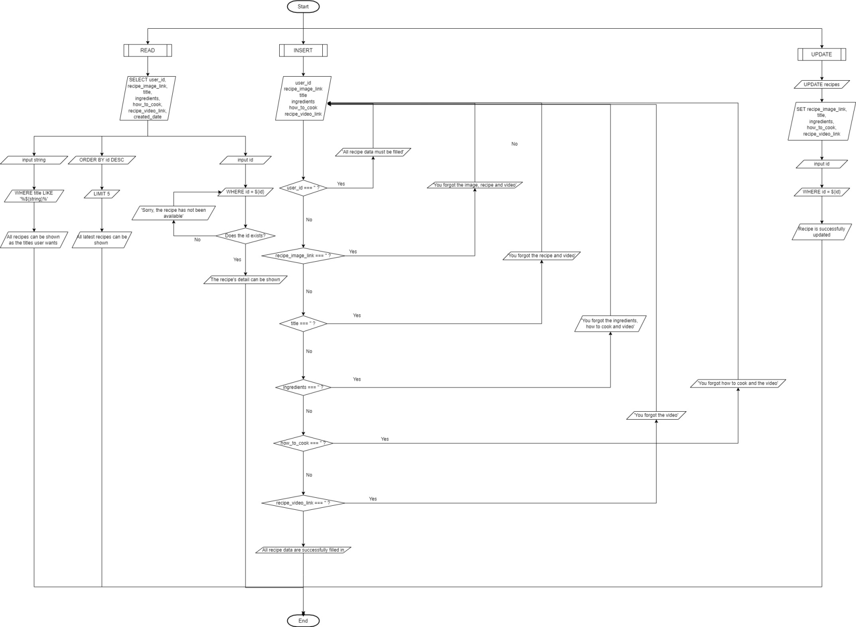
Recipe CRUD Flowchart

Slide 7
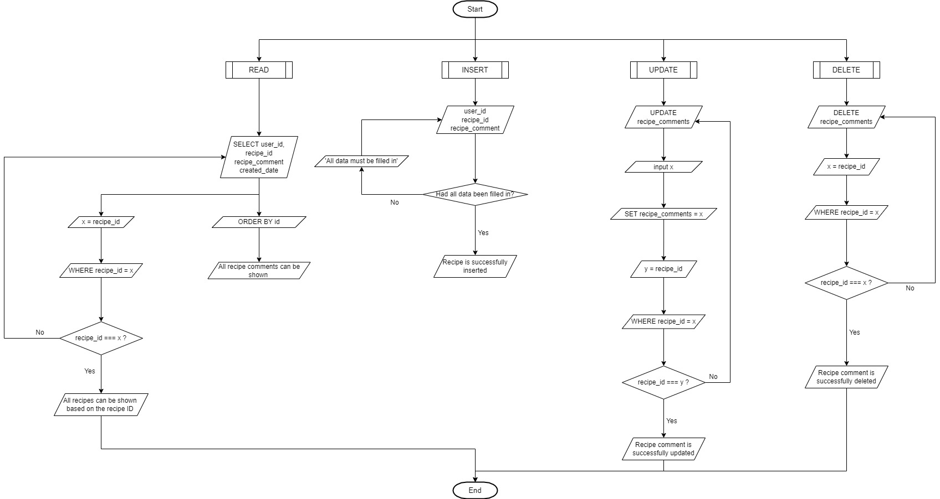
Recipe Comment CRUD Flowchart

Slide 8
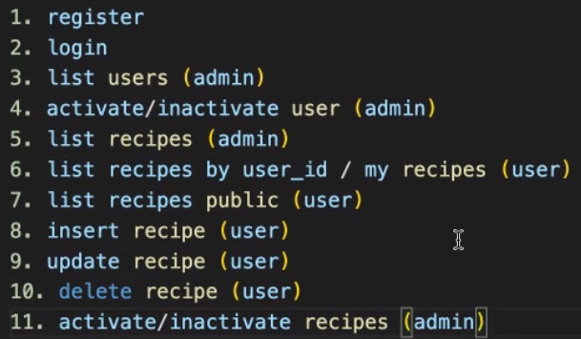
API Demo

Slide 9
Any Question Before Closing?

Slide 10
Thank You

